Slide 1

AL & NL Batting Totals (HR) During the “Steroid Era.”
Final Capstone | Thinkful | Data Analytics
By: Lisa Alcock

Slide 2
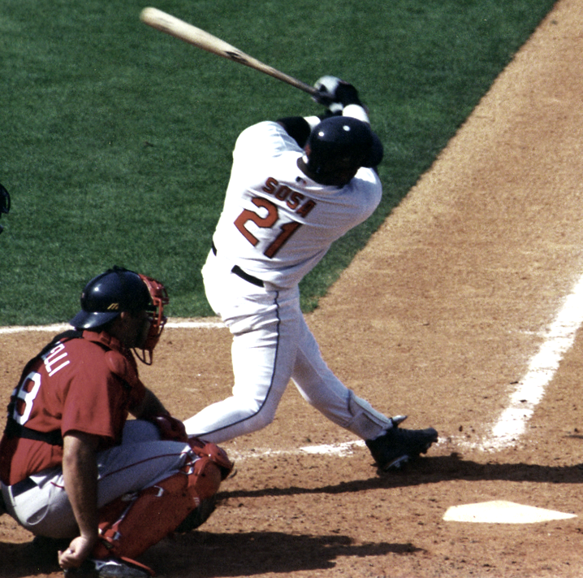
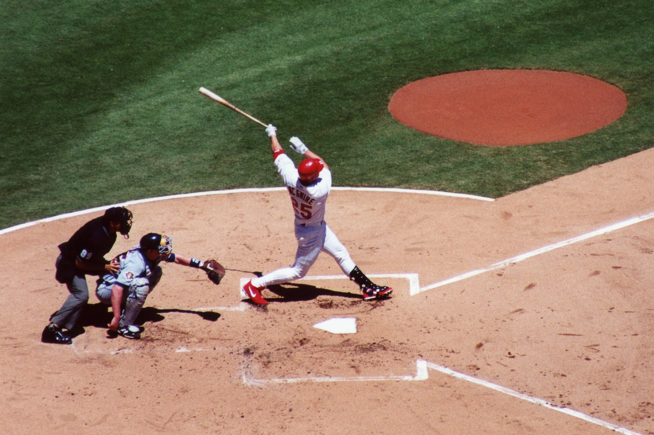
Background
Sammy Sosa, Mark McGwire, Barry Bonds, Jason Giambi, A-Rod, Jose Canseco, Johnny Damon, Manny Ramirez, David Ortiz, Aaron Boone, Gary Sheffield, etc. All of these men have at least one thing in common: failed MLB drug tests and/or suspensions.
Because of the use of performance enhancing drugs (PEDs) by several players, the decade of 1998-2008 became defined as “The Steroids Era.”
Notes:
- Everyone who is a baseball fan remembers the 1998 HR race between Sosa & McGwire, who were trying to beat Roger Maris’s record of 61 HR’s in a single season. McGwire beat Maris’s record in 1998 (70) and then Bonds beat that in 2001 (73). However, some believe that those records have an asterisk next to them because of Sosa’s & McGwire’s use of performance enhancing drugs (PEDs). 1998-2008 became defined as “The Steroids Era.”
-I also realize that other possible factors that could affect HR’s--like weather (ie: in Colorado with high altitude) or, stadiums that are called “hitters ballparks”, ie: the fact that many ballparks have reduced the sizes of left and right fields by bringing in the fences, and the existence of pitcher’s parks. However, I’m not going to look at those possible variables here.

Slide 3
Datasets
I decided to look at AL & NL batting totals datasets that came from Baseball Reference . (I am focusing on HR’s because other stats are already averaged in the data.)
I also grabbed data from a widely-publicized list of players that failed drug testing & were suspended. (Players also named in The Mitchell Report & the Federal grand jury investigation of BALCO).
Notes:
OPS (on-base + slg %) & OBS (H + BB + HBP)/(AB+BB+HBP+SF) are already averaged.
Briefly discuss the MLB drug policy timeline. By 2003 in Spring training, all players were drug tested .
BALCO & Mitchell report.

Slide 4
Research Questions
My research question(s):
Is there a statistical significance when different years between 1998-2008 are compared?
Is there statistical significance between players who tested positive/were suspended for PEDs vs. those that didn’t take any PEDs?
My null hypotheses are that drug use had no effect on the HR numbers over this time period AND, that players who used PEDs had HR numbers that weren’t any different from players who didn’t take PEDs.
Notes:
If you look at HR numbers in tables, you can definitely see an increase, but, is there any statistical significance to those numbers?
*All players are tested when they begin spring training and all players are tested during the year (the date is random though)

Slide 5
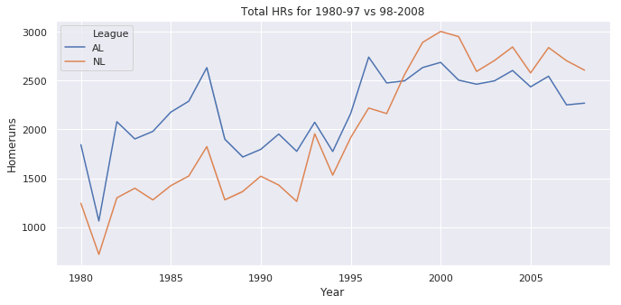
Total HRs: 1980-1997 vs. 1998-2008
If you look at the HR numbers from the decade prior and 98-2008, in tables online, you can see there’s an increase in HRs in both leagues and then a decline for this time period.

Slide 6
Findings--Statistical Significance
After hypothesis testing, I found statistically significant differences between certain years.
The samples with significance:
Positive vs. No PEDs, 1998-2008
AL vs. NL batting (HR’s), 1998-2008
1999 vs. 2007
2000 vs. 2008
2004 vs. 2008
Notes:
After running two-tailed T-tests, I then chose the years that had significant p values <0.05 and difference in means at a 95% confidence interval. I also looked at the Cohen’s d values, or, the measure of the strength of the relationship between the variables (years).

Slide 7
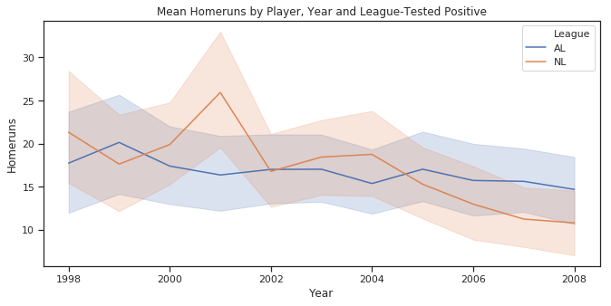
HR’s Players Who Tested Positive and/or Were Suspended
Mean HRs: 16.95
Notes:
The mean # of HRs for PED positive players was 16.95 for the decade. This dataset had 76 players.

Slide 8
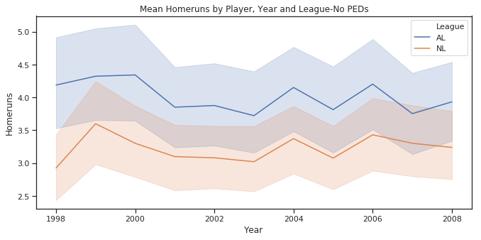
Players, No PEDs
Mean HRs: 3.54
Notes:
The mean # of HR’s for players w/no PEDs is 3.54 for the decade.

Slide 9
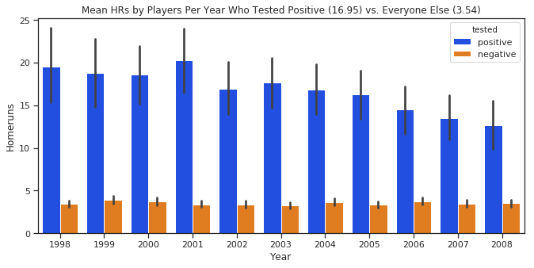
Players Who Tested Positive vs. No PEDs: 98-2008
p=0.000, @95%: -14.423 & -12.38, CD: 1.19
Notes:
You don’t really see the difference until the results are plotted on the same chart. 16.95 vs. 3.54 HR mean

Slide 10
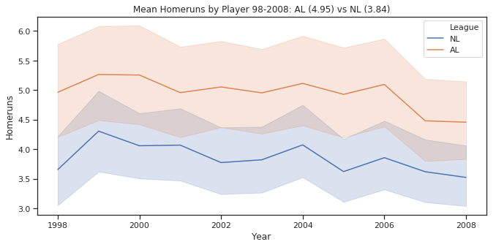
AL vs. NL HRs 1998-2008
p=2.242e-14, @ 95%: 0.819 & 1.394, CD: 0.13
Notes:
P value is < 0.05 difference in the means is 0.819 & 1.394. The strength of the relationship between the variables is small at 0.132.

Slide 11
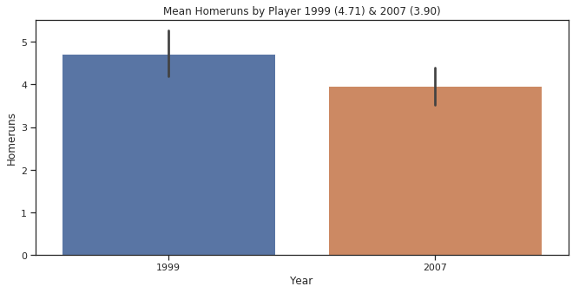
1999 vs. 2007
p=0.027, @ 95% confidence: -1.419 & -0.079, CD= 0.08
Notes:
P <0.05, difference in means is -1.419 & -0.079. The effect size is small.

Slide 12
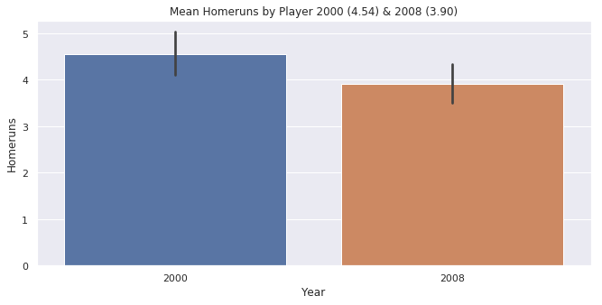
2000 vs. 2008
p=0.047, @ 95% confidence: -1.27 & -0.008 HRs, CD: 0.07

Slide 13
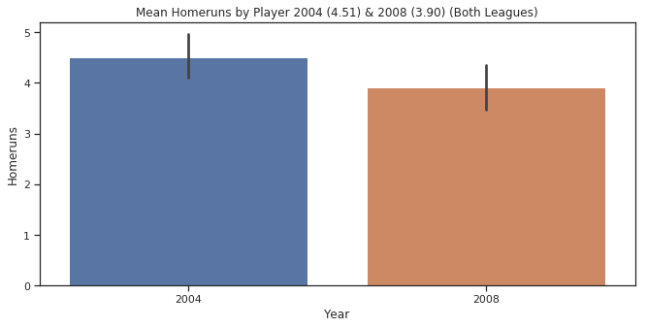
2004 vs. 2008
p=0.05, @ 95%: difference in HR means is between -1.237 & 0.020. CD: 0.07

Slide 14
Final Thoughts, Things to Think About
While I didn’t find significance for all years, I did find 5 different instances of statistical significance in the data. However, the Cohen’s d numbers for several were quite small in their effect sizes between the variables.
I think my findings add strength to the argument that PEDs did affect HR numbers.
I am still encouraged by my findings here and I will continue to study this subject. I’d like to create some more datasets, post-2008-present and run statistical tests on them, as well as some for the 1980’s-90’s.

Slide 15
The Effect on MLB
In 2007, I think The Mitchell Report summed it up perfectly:
“The illegal use of performance-enhancing substances poses a serious threat to the integrity of the game. Widespread use by players of such substances unfairly disadvantages the honest athletes who refuse to use them and raises questions about the validity of baseball records.”

Slide 16
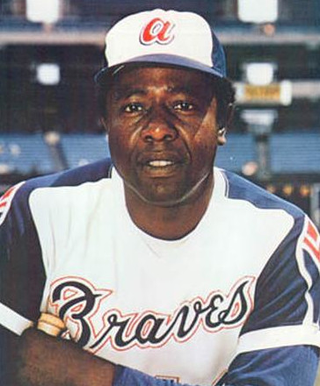
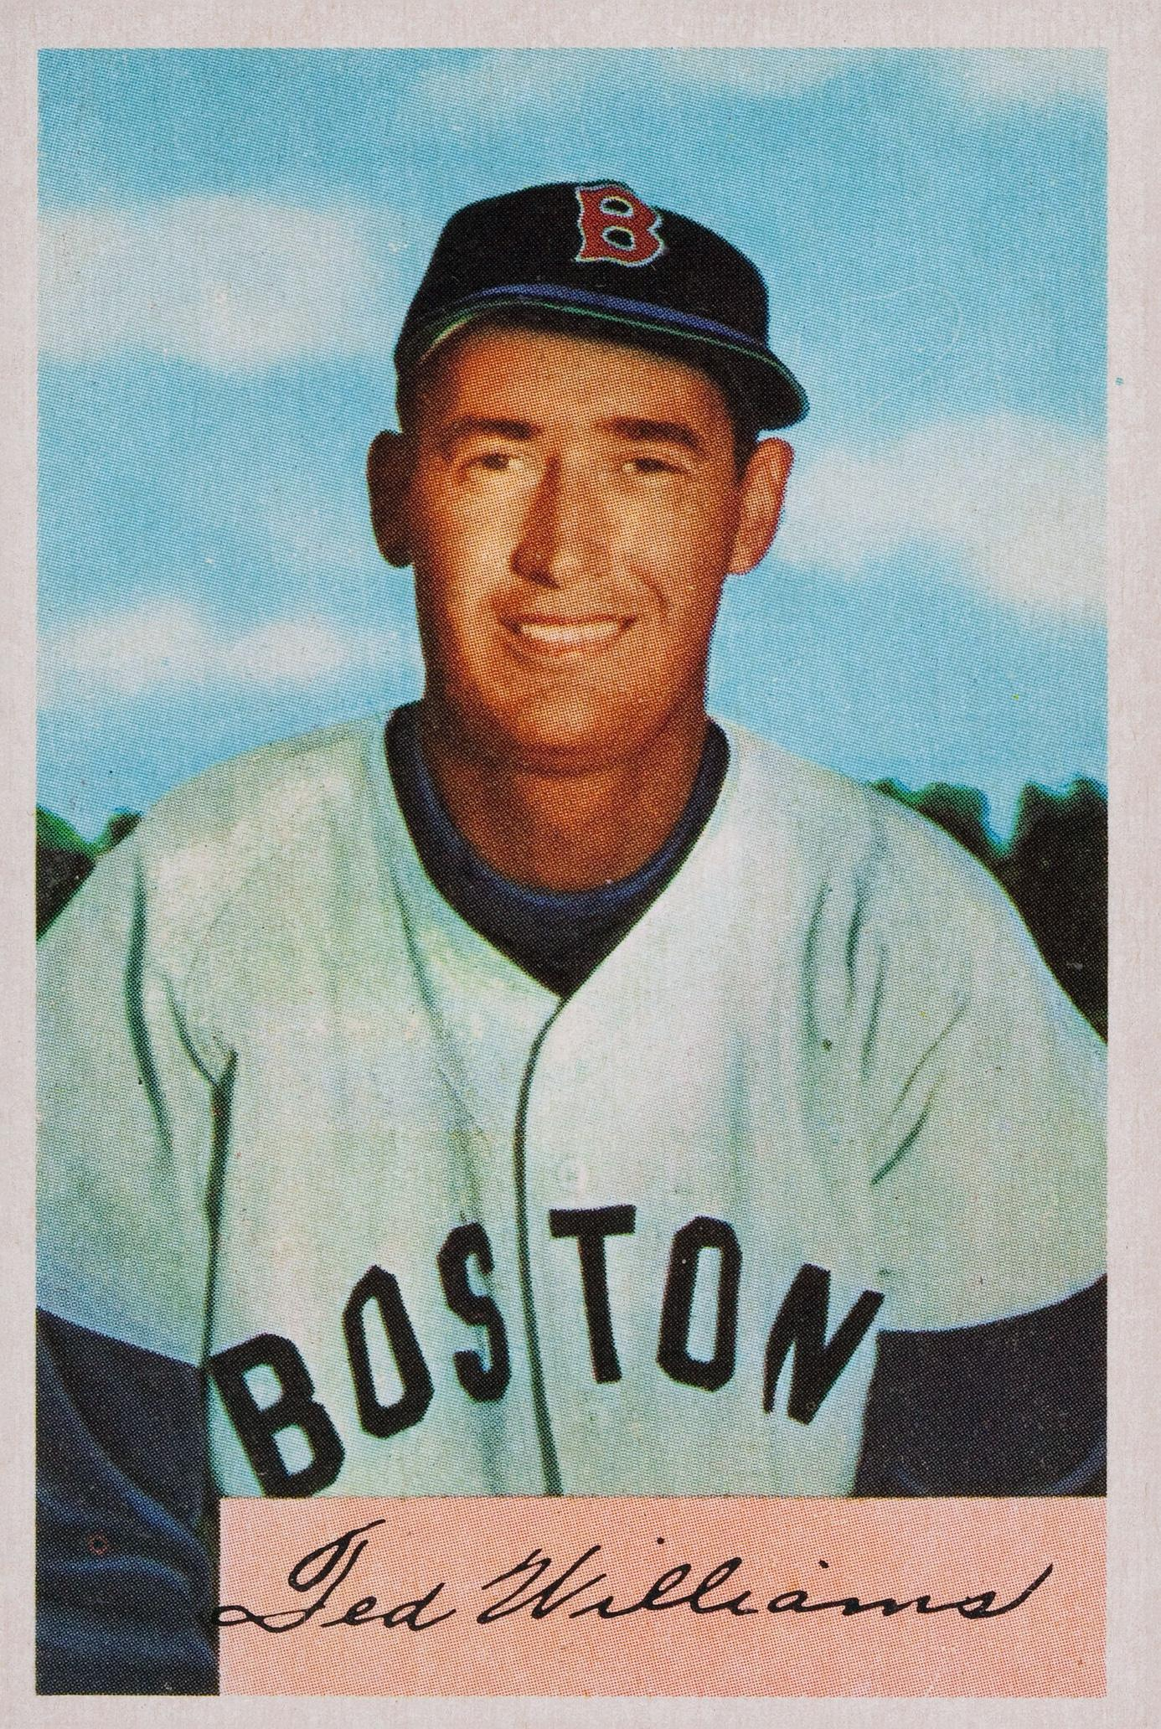
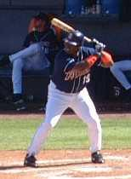
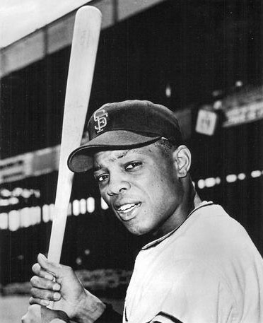
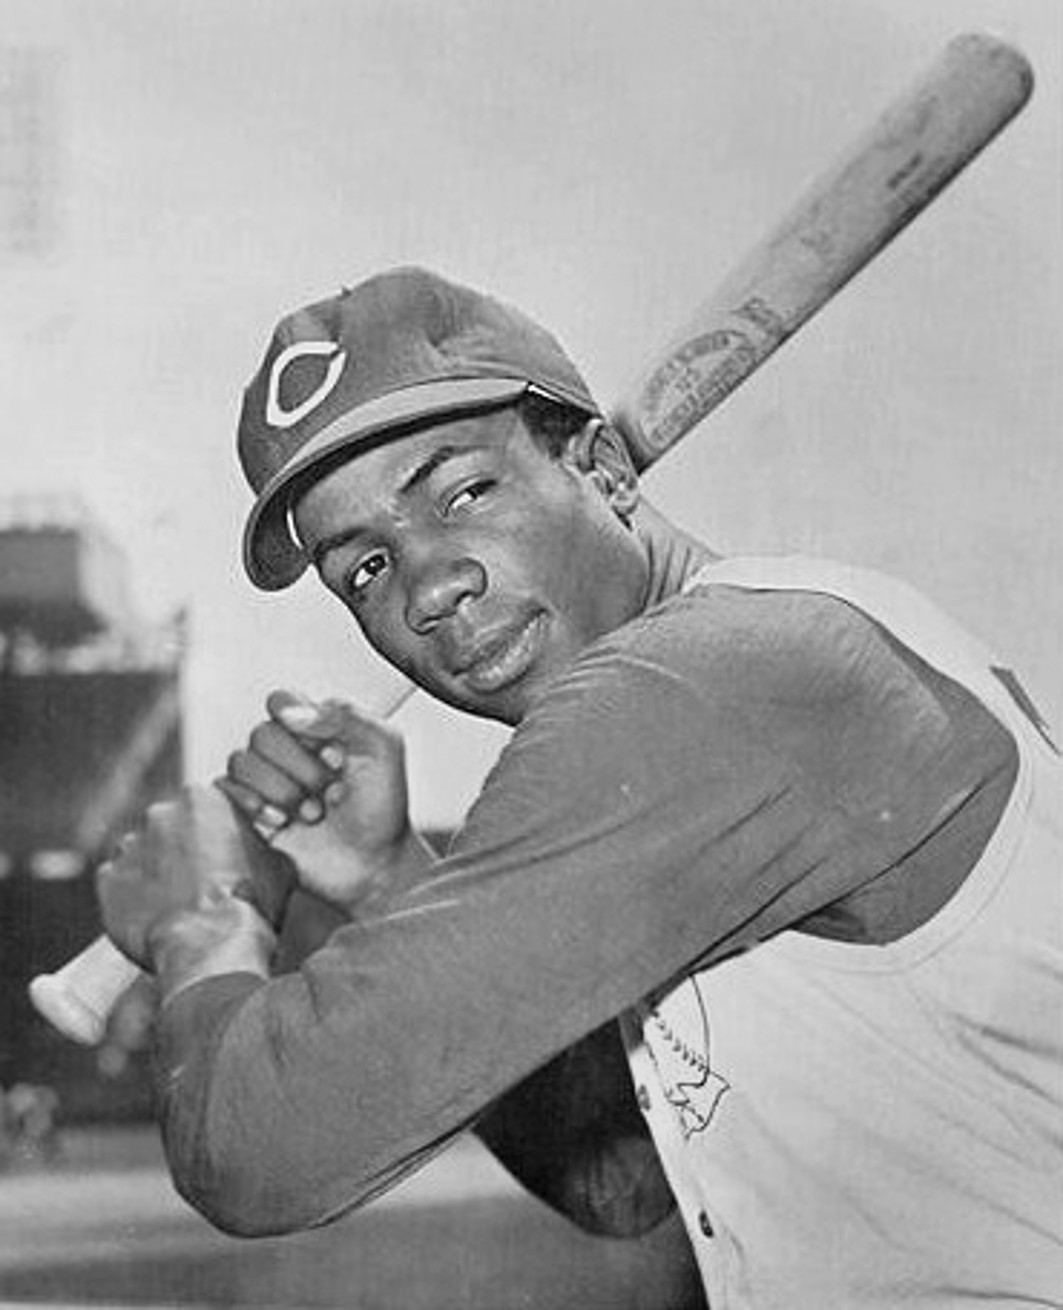
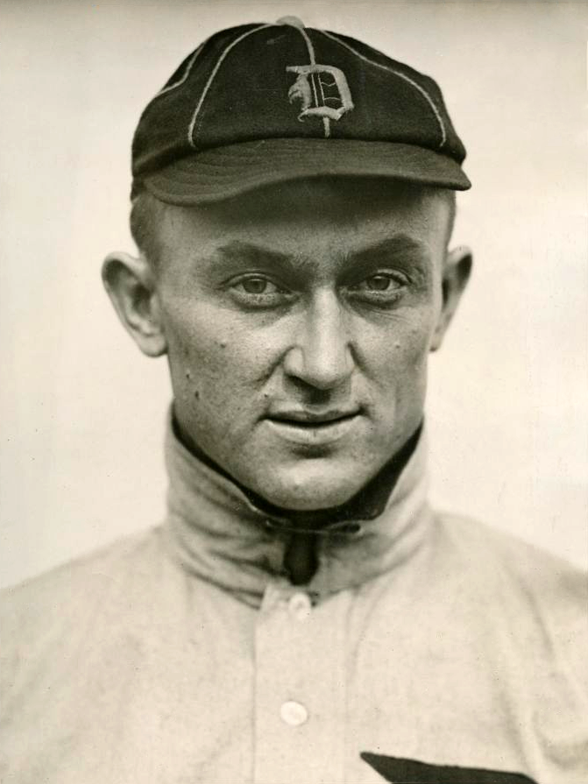
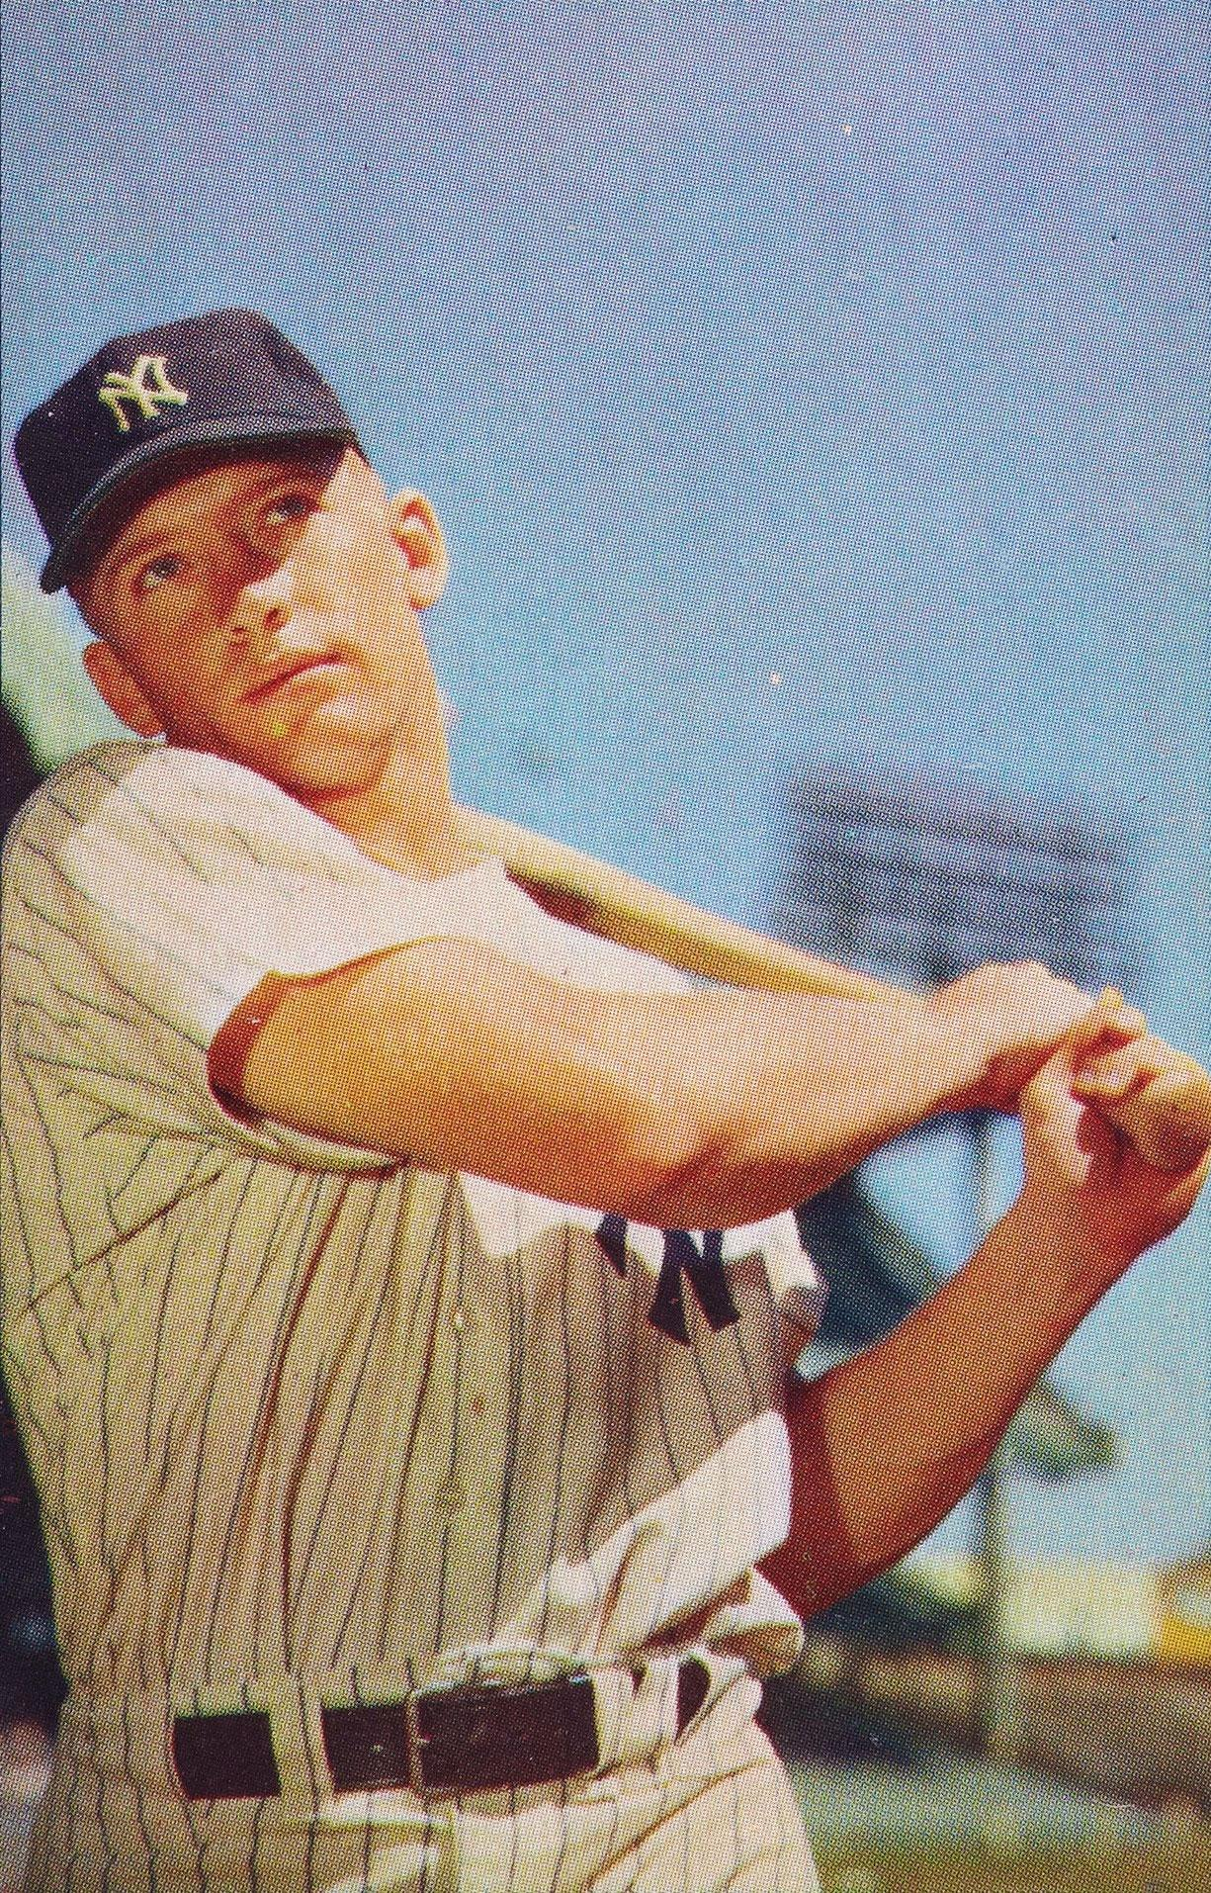
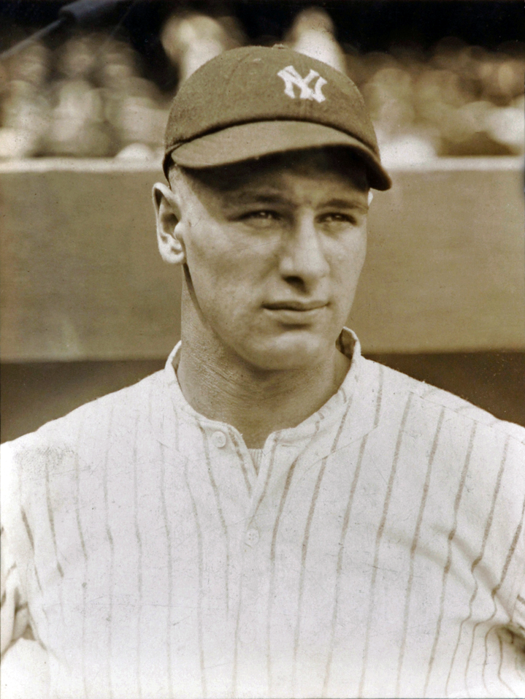
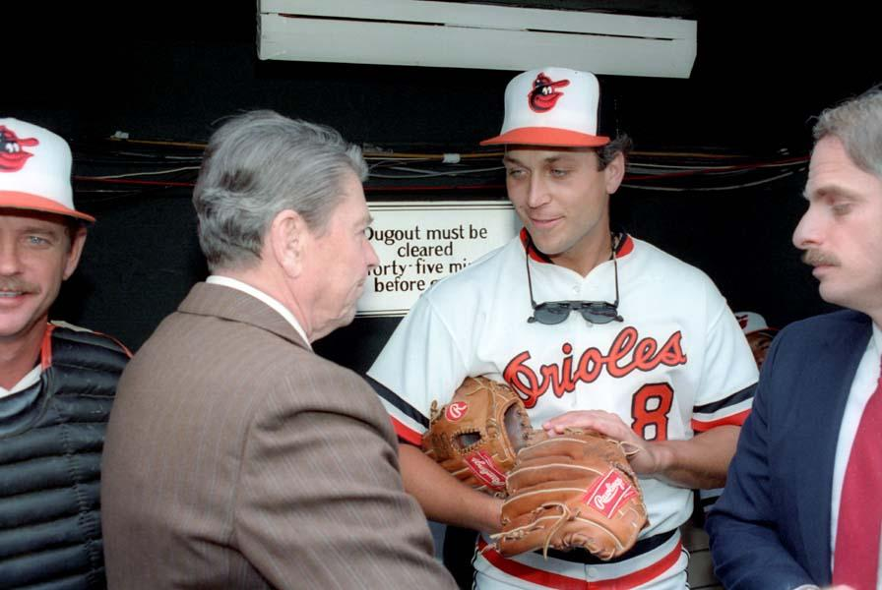
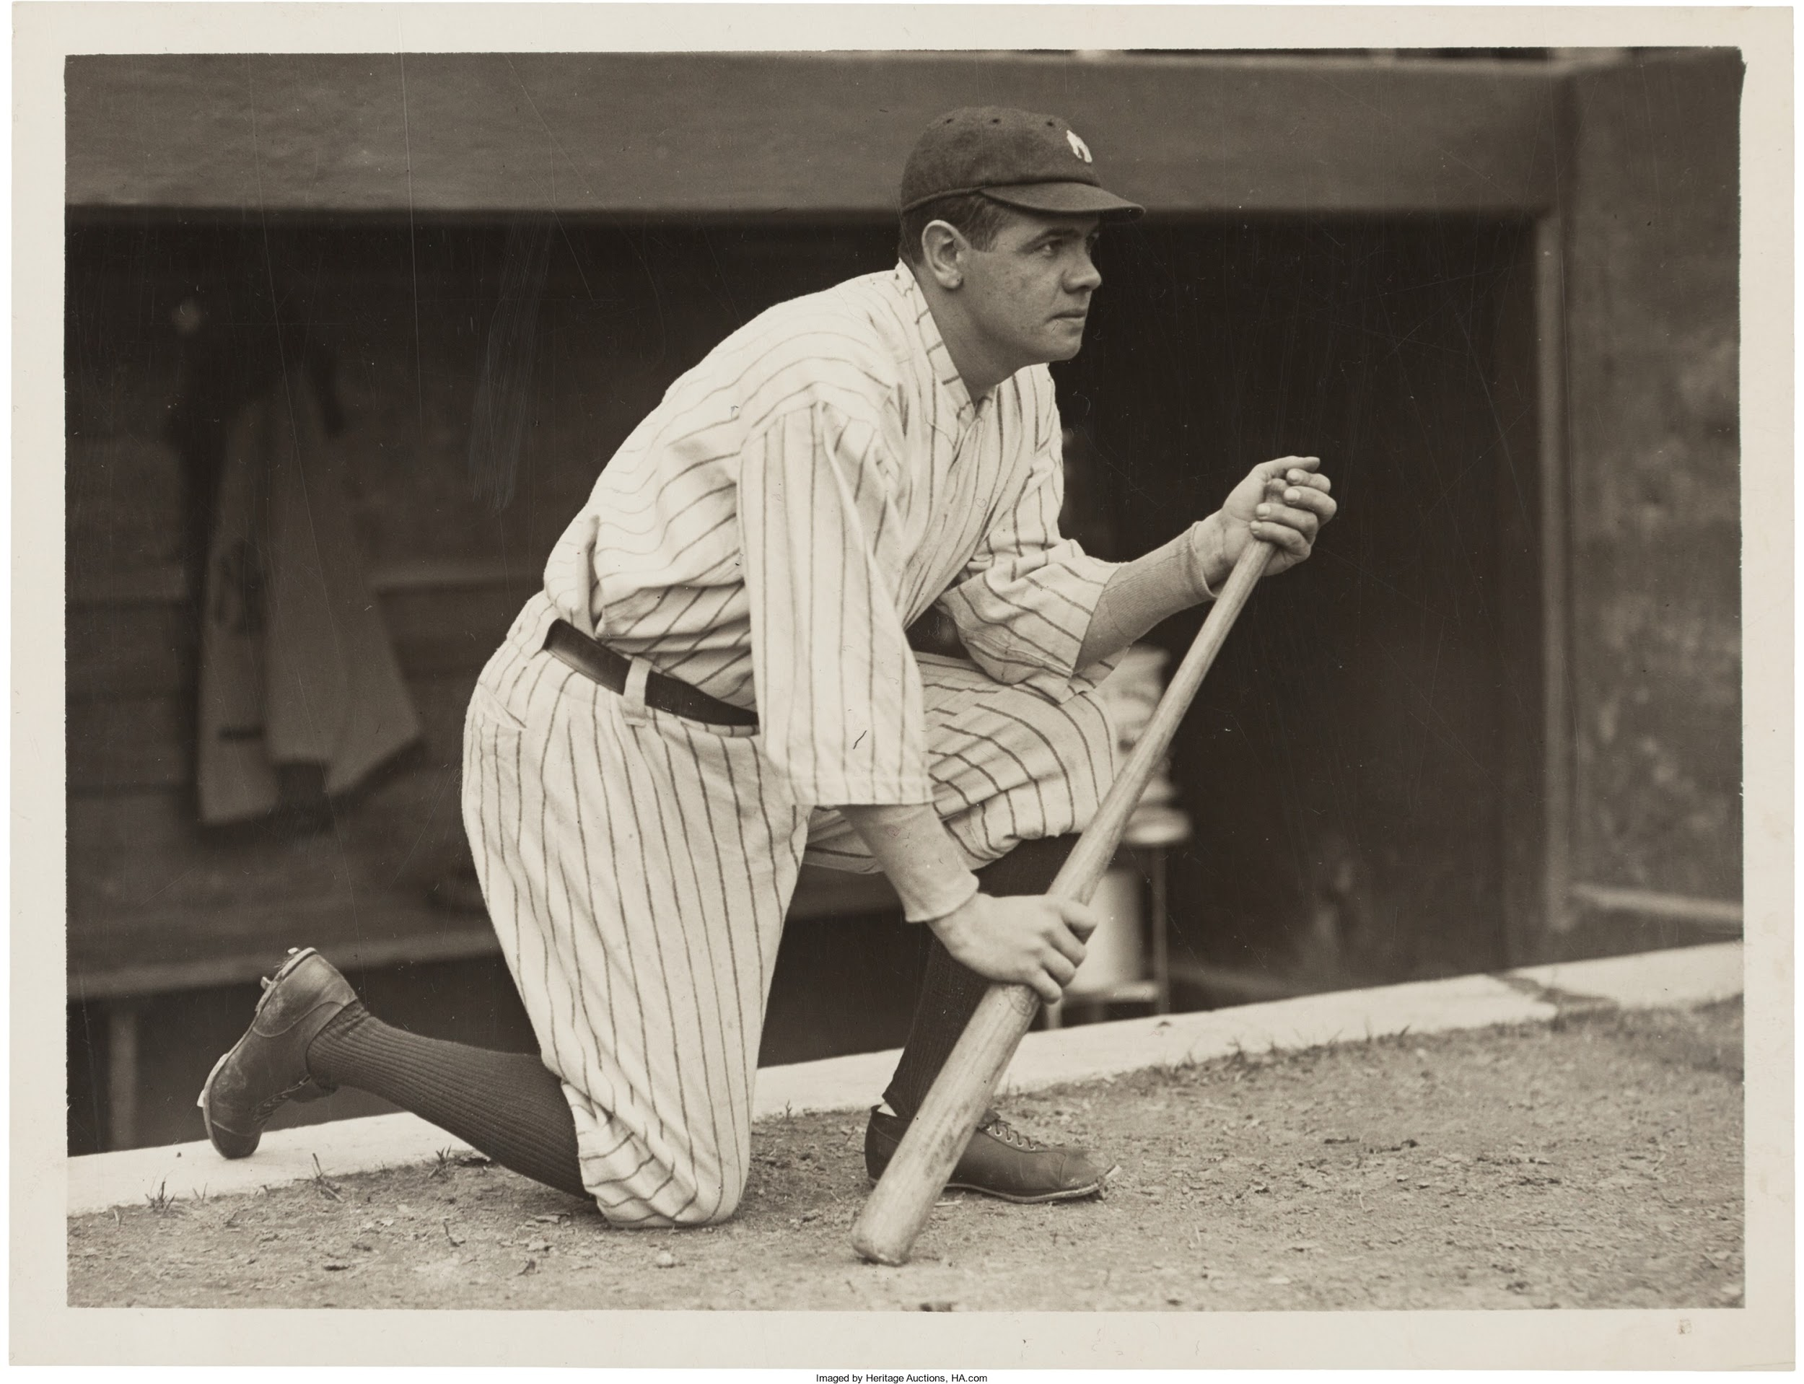
Thank you for attending!
Notes:
HR leaders & great hitters: Hank Aaron, Ted Williams, Tony Gwynn, Willie Mays, Frank Robinson, Cal Ripken, Mickey Mantle, Lou Gehrig, Babe Ruth, Ty Cobb..

Slide 17
Appendix - MLB Drug Policy - (for reference)
PED Policy.
A Brief History of MLB drug testing that’s relevant to this study:
1991- Steroids made the list of banned substances. However, there wasn't official testing in MLB.
2003-2004- The Players Assoc. (MLBPA) & owners agreed on a new (anonymous) testing policy. Urine tests for banned substances began. A first positive test results in treatment and a second in a 15-day suspension without pay or fine of up to 10K. Penalties increase to a 25-day suspension or fine of up to 25K for a third positive test, a 50-day suspension or a fine of up to 50K for a fourth and a one-year suspension or fine of up to 100K for a fifth.' (USA Today, 2014).

Slide 18
Appendix
*Also, of note: It was later learned that the results of these tests from 2003 were then turned over to an Federal Grand Jury investigation into BALCO (Bay Area Laboratory Co-Operative). A list of players was leaked and became published online in many venues.
2005- The players & owners agreed again on stronger penalties: 1st time: 50-day suspension, 2nd time: 100-day ban, 3rd: lifetime
2006- Then Commissioner of the MLB, Bud Selig, ordered an investigation into illegal substances in MLB. He appointed Sen. George Mitchell, who led a 20 month investigation into steroid and HGH (human growth hormone, also banned) use in MLB. Former batboys, clubhouse attendants and trainers were questioned. Out of 5 players that were asked to co-operate b/c of their public comments about testing and drug use in MLB, only one, Frank Thomas gave testimony.

Slide 19
Appendix
The results of the investigation were published in a report in December 2007. Mitchell’s investigation focused on “high profile” players. (online, Wikipedia, ESPN, etc.)
The drug policy has changed several times since the Report came out and penalties have become more strict, including heavy fines for not attending treatment programs.
In Jose Canseco’s 2005 book, “Juiced,” he named several players--McGwire, Rafael Palmeiro, Pudge Rodriguez, Juan Gonzalez, Jason Giambi. All players claimed his allegations were false. Canseco also said that amphetamines were more widely used in MLB.
Bonds & McGwire also testified during the federal grand jury investigation of BALCO.

Slide 20
Appendix - Data References
Baseball Reference site.
Players named in the Mitchell Report, here.
The Mitchell Report.
Players suspended, here.
The list leaked in 2009 of the players who tested positive in 2003, here.
MLB Drug Policy Timeline Coverage, here.
Interesting article about players who took steroids & HOF chances, here.

Slide 21
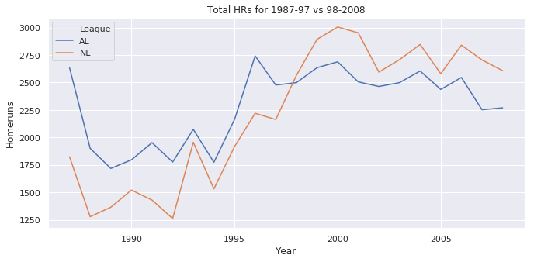
Appendix: Total HRs 1987-97 vs. 1998-2008
P <0.05, Difference in the means of HRs @ 95% is 547 & 927, CD=-2.29

Slide 22
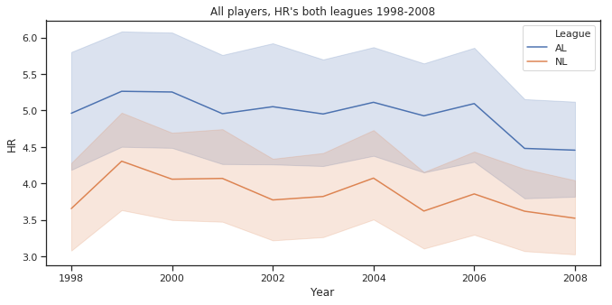
Appendix: Looking at Overall HR Numbers (mean)
If you look at the HR numbers from 1998-2008 in tables online, you can see there’s an increase in HRs in both leagues and then a decline for this time period.
Notes:
The current NL HR leaders are Eugenio Suárez & Pete Alonso (49).
AL: Trout & Bellinger & Soler ( all at 45) ?

Slide 23
Appendix
Footnotes (slide 2):
1 Maris’s record was controversial at the time b/c he beat out Babe Ruth, who had previously held the record with 60 HR in 154 games while Maris hit 61 in 162 games.
2 I also realize that other possible factors that could affect HR’s--like weather (ie: in Colorado with high altitude) or, stadiums that are called “hitters ballparks”, ie: the fact that many ballparks have reduced the sizes of left and right fields by bringing in the fences, and the existence of pitcher’s parks. However, I’m not going to look at those possible variables here.

